Slide 1


Presented by Ghazal Mehrabizade
Optimizing Pharmaceutical Sales
Insights, Trends, and Strategic Opportunities
orchidpharmed.com

Slide 2
Company Representative
Orchid Farmed operates in the field of marketing for pharmaceutical products. One of the main pillars of the company is the sales and marketing team. Along with the many positions in this team, one of the most important positions is the scientific representative or MedRep.
The main representative is to meet with doctors and provide manufactured drugs. For this purpose, the meeting plan team announces to MedRep.
Agents are obliged to implement their own plans.
Sky's The Limit

Slide 3
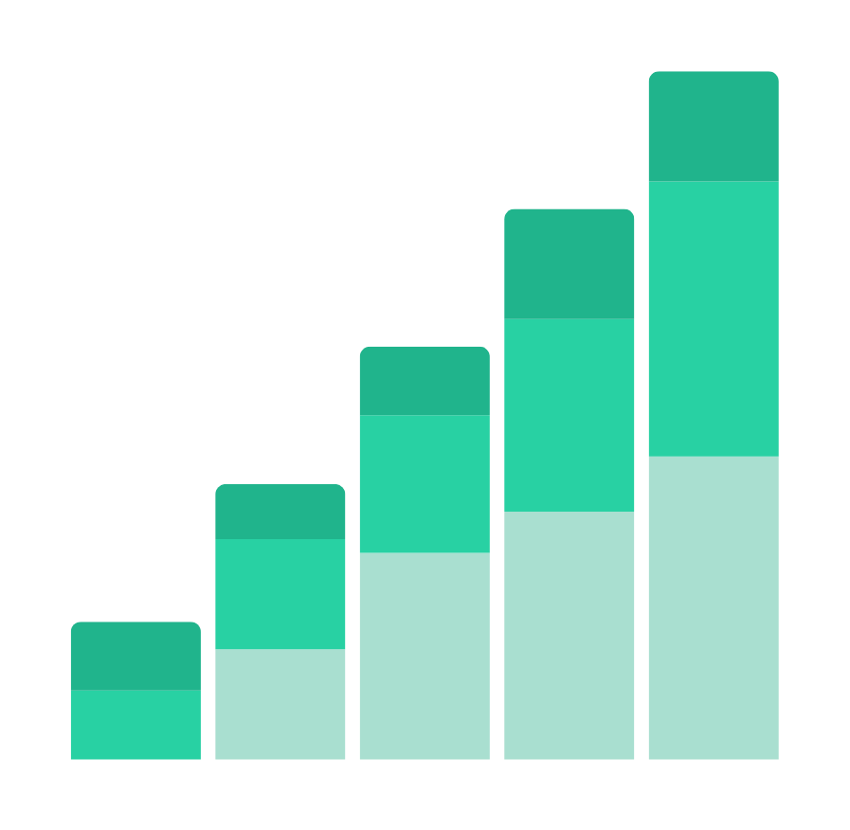
Description Of The Data
The data used includes the information and visits of doctors in the direction of drug introduction. This file contains detailed information
Visits, doctors' information, drug information, scientific representatives' information, and each representative's monthly performance target information.

Slide 4

Data Preparation Process
In this report, the ETL (Extract, Transform, Load) process is defined as the first essential step for data analysis. In this phase, raw data is extracted from various sources such as databases and Excel files. Then, through the transformation process, this data is cleaned, aggregated, and structured to improve incomplete and inconsistent information and to convert the data into a suitable format for analysis. Finally, the prepared data is loaded into a storage system or analytical database to be used for deeper analysis and the creation of final reports. This process helps us transform data into meaningful insights and make strategic and precise decisions in pharmaceutical marketing.

Slide 5

Challenges and proposed solutions
Working with Persian date in Power BI has some challenges, because this tool supports Gregorian calendar by default.
Adding a DimDate table to Power BI enhances your ability to perform time-based analyses and leverage the benefits of a date dimension table. This table helps you easily filter, group, and perform time-related calculations on your data. Here’s how you can add and configure a DimDate table in Power BI

Slide 6
Orchid Farmed Questions
Let’s Go...

Slide 7


Question 1
Typically, physicians are regularly visited for each medication. If a physician has been visited more than three times for a specific medication and the visits are not repeated afterward, the physician is considered "dropped" for that medication. Calculate the drop rate of physicians for each product, grade, and month.

Slide 8
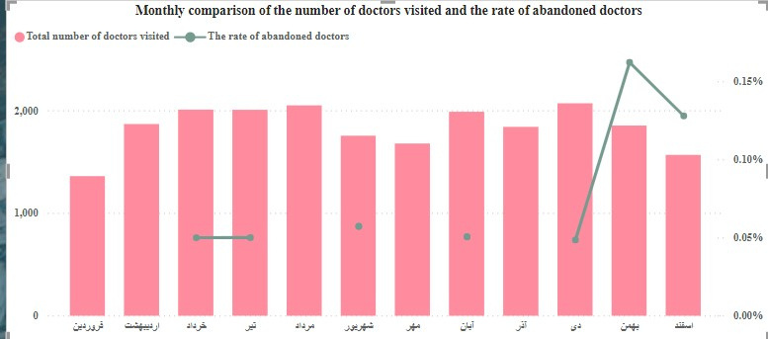
CountOfDr =DISTINCTCOUNT(FactVisit[PhysicanId])
SummarizedVisitTable =
SUMMARIZECOLUMNS(
FactVisit[PhysicanId],
FactVisit[YearMonth],
FactVisit[ProductID],
FactVisit[DrGrade],
"TotalOfvisit",
SUM(FactVisit[VisitCount]),
"LastVisit",
CALCULATE(MAX(FactVisit[YearMonth]),ALL(FactVisit[YearMonth]))
)
DroppedDr =
CALCULATE(
DISTINCTCOUNT('SummarizedVisitTable'[PhysicanId]),
'SummarizedVisitTable'[TotalOfvisit]>3,
'SummarizedVisitTable'[YearMonth]='SummarizedVisitTable'[LastVisit]
)
DroppedRate =
DIVIDE(
[DroppedDr],
[CountOfDr]
)

Slide 9
Question 2
It is important to us that if we plan to visit a physician regularly, that physician should be included in our plan so that our representative visits the physician according to a defined schedule. However, the sales and marketing team might be uncertain about adding a physician for a specific medication to the plan. Therefore, if these visits occur a maximum of two times and then do not continue, we classify that physician for that medication under the "Gathering Data" category. Calculate the percentage of visits that fall into this category each month and for each medication, considering those visits that are not part of the original plan.

Slide 10
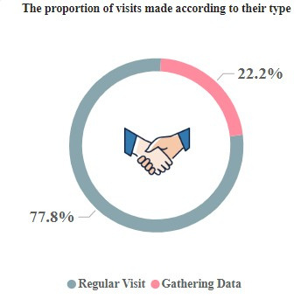
VisitType =
IF(
AND(
'SummarizedVisitTable'[TotalOfvisit] <= 2,
'SummarizedVisitTable'[YearMonth]='SummarizedVisitTable'[LastVisit]
),
"Gathering Data",
"Regular Visit"
)

Slide 11
Question 3
As you can see in the Target file, it specifies which physicians each medical representative should visit on a given day, and we expect these visits to proceed according to this schedule. Based on your analytical skills, classifications, and the information provided in the previous questions, provide an appropriate analysis comparing the Target and Actual visits for different categories.

Slide 12
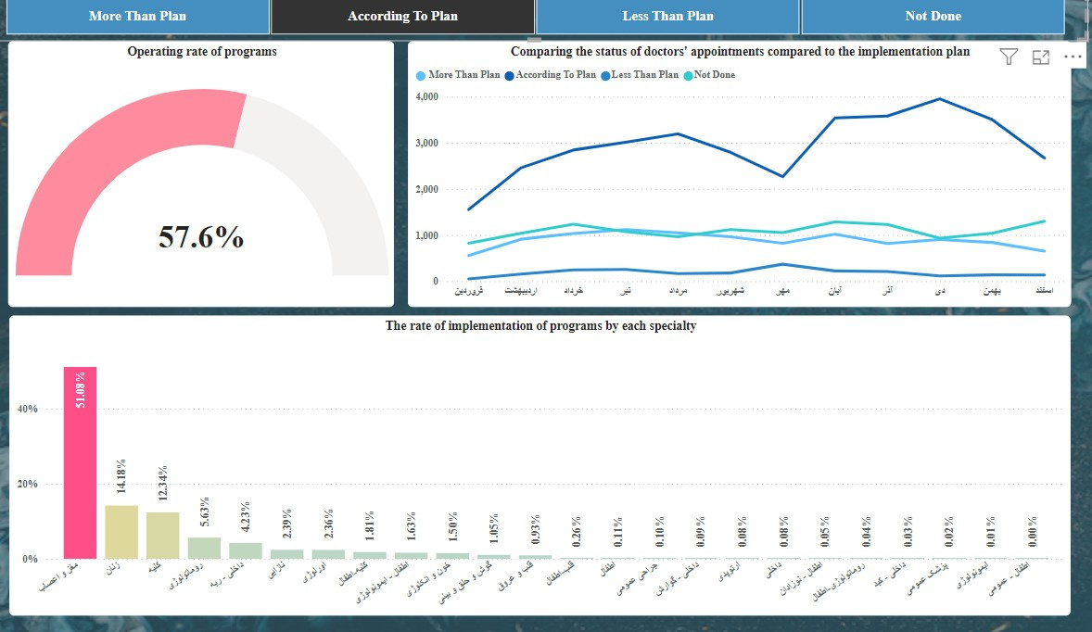
Actual =
VAR ActualValue =
CALCULATE(
SUM(FactVisit[VisitCount]),
USERELATIONSHIP(FactTarget[ID],FactVisit[ID])
)
RETURN
IF(
ISBLANK(ActualValue),
"Not Done ",
IF(
FactTarget[VisitTarget]=ActualValue,
"According To Plan",
IF(
FactTarget[VisitTarget]<ActualValue,
" More Than Plan",
"Less Than Plan"
)))

Slide 13
Question 4
We have visits that are outside the plan, and therefore, no grade has been assigned to them. Additionally, there are rows in the plan that do not have a grade, and as previously mentioned, these should be replaced with grade C.

Slide 14
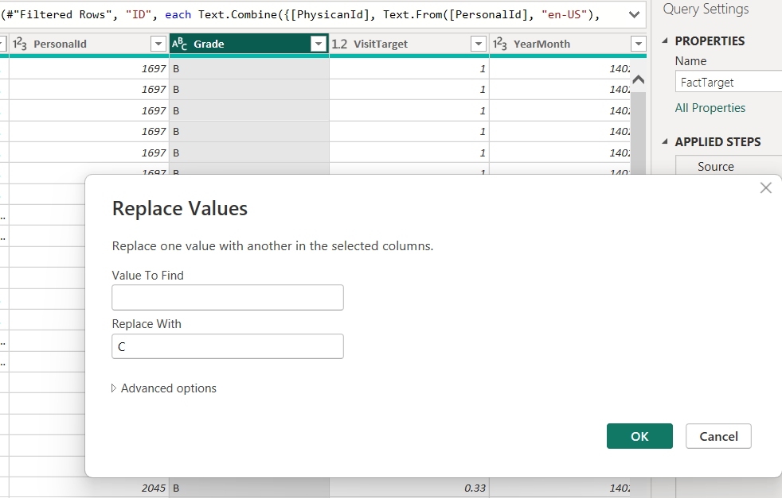

Slide 15
Question 5
Can you, based on the data and the rows that have grades, find a grade as close to reality as possible for these null grades, both in the visits and in the targets?

Slide 16
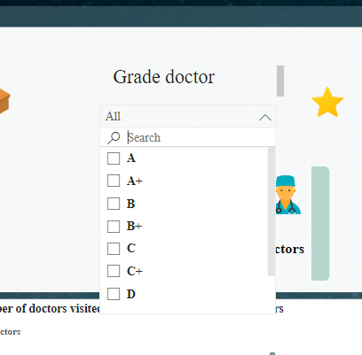
DrGrade =
VAR ModeValue =
CALCULATE(
FIRSTNONBLANK(FactTarget[Grade], 1),
FILTER(
FactTarget,
FactTarget[Grade] <> BLANK()
),
TOPN(
1,
VALUES(FactTarget[Grade]),
COUNTROWS(FILTER(FactTarget, FactTarget[Grade] = EARLIER(FactTarget[Grade]))),
DESC
)
)
VAR DrGrade = LOOKUPVALUE(FactTarget[Grade],FactTarget[ID],FactVisit[ID])
RETURN
IF(
ISBLANK(DrGrade),
ModeValue,
DrGrade
)

Slide 17
Question 6
What are your recommendations for improving the observed pharmaceutical marketing strategies based on this data?

Slide 18
1. تحلیل عمیق‌تر رفتار پزشکان بر اساس تخصص
شناسایی پزشکان کلیدی: با تحلیل داده‌های ویزیت (VisitCount) و تخصص پزشکان (SpecialityName)، می‌توانید پزشکان کلیدی را در هر تخصص شناسایی کنید. توجه ویژه به این پزشکان و ارائه برنامه‌های آموزشی و بازاریابی هدفمند می‌تواند منجر به افزایش نسخه‌نویسی داروهای شما شود.
1. Deeper analysis of doctors' behavior based on expertise
Identification of key doctors: By analyzing the data of visits (VisitCount) and specialty of doctors (SpecialtyName), you can identify key doctors in each specialty. Paying special attention to these doctors and offering targeted marketing and educational programs can lead to an increase in your prescriptions.

Slide 19
2. تقسیم‌بندی جغرافیایی و تمرکز منطقه‌ای
تحلیل عملکرد منطقه‌ای: از داده‌های جغرافیایی برای شناسایی مناطق با عملکرد بالا و پایین استفاده کنید. در مناطقی که عملکرد خوبی دارند، برنامه‌های بازاریابی را تقویت کنید و در مناطقی که عملکرد ضعیفی دارند، دلایل آن را تحلیل کرده و استراتژی‌های جدید ارائه دهید.
کمپین‌های بازاریابی محلی: کمپین‌های بازاریابی منطقه‌ای را با توجه به شرایط خاص هر منطقه طراحی کنید. این کمپین‌ها می‌توانند شامل تخفیف‌های ویژه، سمینارهای محلی، یا تبلیغات محلی باشند.
2. Geographical division and regional concentration
Regional Performance Analysis: Use geographic data to identify high and low performing regions. Strengthen marketing programs in areas that are performing well, and analyze why and propose new strategies in areas that are underperforming.
Local marketing campaigns: Design regional marketing campaigns according to the specific conditions of each region. These campaigns can include special discounts, local seminars, or local promotions.

Slide 20
3. تحلیل محصولات برتر و کم‌فروش
تجزیه و تحلیل محصولات پرطرفدار: محصولات پرفروش را شناسایی کرده و دلیل موفقیت آنها را تحلیل کنید. این تحلیل می‌تواند به بهبود بازاریابی داروهای کم‌فروش کمک کند.
تمرکز بر داروهای کم‌فروش: با استفاده از داده‌ها، داروهایی که عملکرد ضعیف‌تری داشته‌اند را شناسایی کرده و دلایل آن را بررسی کنید. ممکن است این داروها به تبلیغات یا آموزش بیشتری نیاز داشته باشند.
3. Analysis of top and low-selling products
Hot Products Analysis: Identify top selling products and analyze the reason for their success. This analysis can help improve the marketing of low-selling drugs.
Focus on underperforming drugs: Use data to identify underperforming drugs and investigate why. These drugs may need more advertising or education.

Slide 21
4.همکاری با سازمان‌های پزشکی و بیمه‌ها
همکاری استراتژیک: همکاری نزدیک با سازمان‌های پزشکی و بیمه‌ها برای ترویج داروها و ارائه تخفیفات ویژه به بیمه‌شدگان می‌تواند تقاضا را افزایش دهد.
4.Cooperation with medical and insurance organizations
Strategic cooperation: Close cooperation with medical organizations and insurance companies to promote drugs and offer special discounts to the insured can increase demand.

Slide 22

Presented by Ghazal Mehrabizade
Thank you very much!
orchidpharmed.com

